Slide 1

AI BLUE TEAM AND INTRO TO AI RED TEAMING BOOTCAMP
Foundations
MODULE
1
AI for Blue Team Operations
How AI is changing defensive security work
Day 1
2 hours
Hands-on labs
Presenter: Dr. Gaspard Baye, Valix AI + Evolve Academy

Slide 2
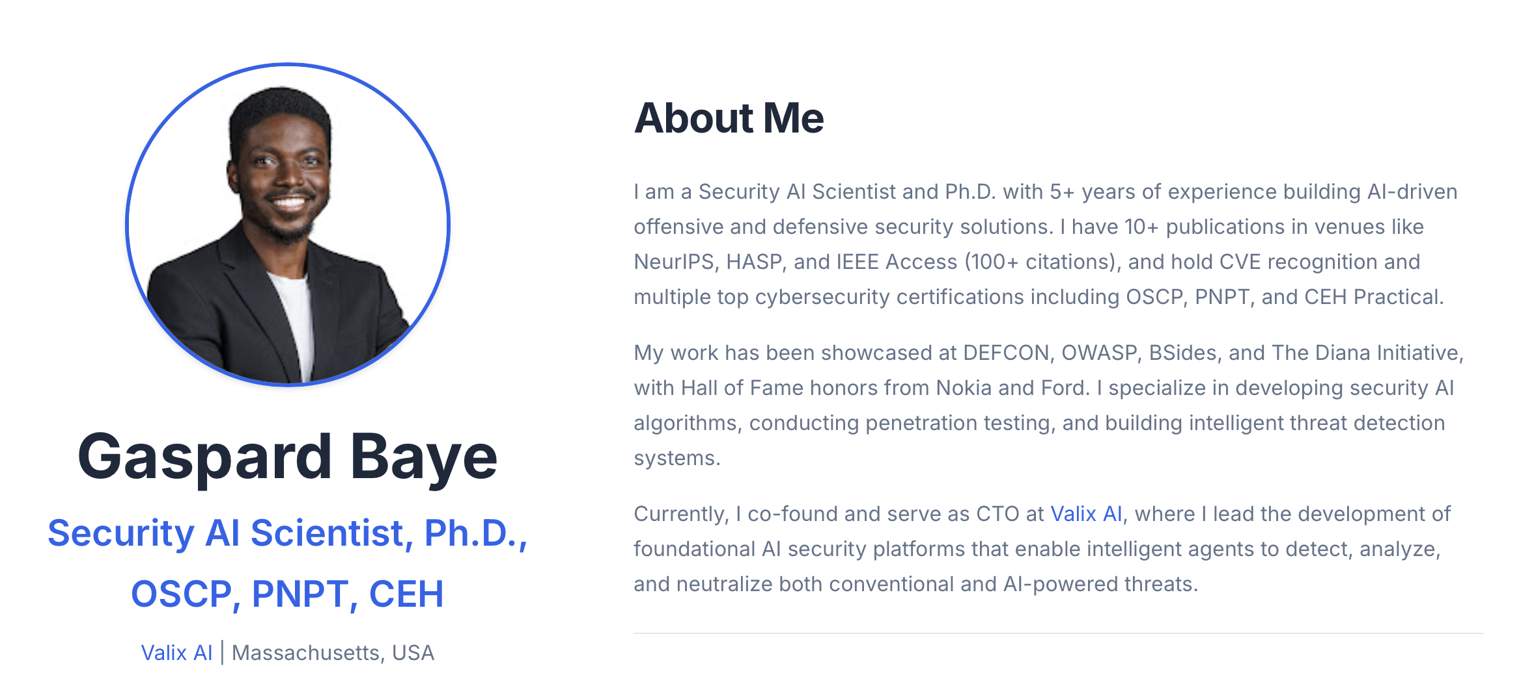
Whoami?

Slide 3
2-HOUR SESSION
How today runs
0:00 - 0:20
0:20 - 1:40
1:40 - 2:00
Concept and demo
Guided hands-on labs
Debrief and Q and A
LABS IN THIS SESSION
Lab 1.1
Connect to Ollama and Wazuh, and check the GPU
Lab 1.2
Your first AI conversation for security
Lab 1.3
AI-assisted log triage
Lab 1.4
Tour the Wazuh SIEM
Valix AI x Evolve Academy | AI Blue Team Bootcamp
Module 1 | 02

Slide 4
THE ROAD AHEAD
Where this fits in the week
Day 1
Day 2
Day 3
Day 4
Day 5
Foundations
Detection
Prompt engineering
AI red teaming
Capstone
You are here: Day 1
Valix AI x Evolve Academy | AI Blue Team Bootcamp
Module 1 | 03

Slide 5
WHY AI, WHY NOW
The problem: analysts are drowning in alerts
11k+
60%
30 min
alerts per day in a busy SOC
of alerts never get fully investigated
to triage a single alert by hand
Numbers are illustrative. AI does not replace the analyst; it removes the slow first pass so people focus on judgment.
Valix AI x Evolve Academy | AI Blue Team Bootcamp
Module 1 | 04

Slide 6
MINUTES PER TASK
Where AI saves time
Illustrative. AI-assisted work still ends with a human check.
Valix AI x Evolve Academy | AI Blue Team Bootcamp
Module 1 | 05

Slide 7
THREE EVERYDAY WINS
Where AI helps across the SOC
Log analysis
Turn thousands of raw lines into a plain-language summary and a verdict.
Alert triage
Rank what matters first and explain why, with the evidence cited.
Incident response
Draft timelines, summaries, and reports so responders move faster.
Valix AI x Evolve Academy | AI Blue Team Bootcamp
Module 1 | 06

Slide 8


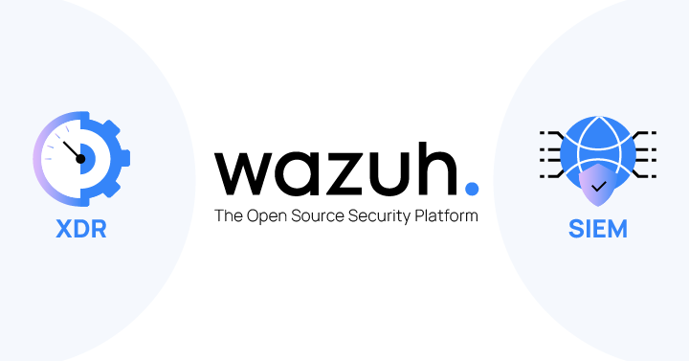
YOUR TOOLKIT
The tools you will use
Ollama and llama3.1 8b
A large language model running on the lab GPU. Private, and no data leaves the lab.
Wazuh 4.14
The SIEM. It collects logs, applies rules, and raises alerts.
Shared Python clients
ollama_client and wazuh_client connect the two in a few lines of code.
Valix AI x Evolve Academy | AI Blue Team Bootcamp
Module 1 | 07

Slide 9
THE ARCHITECTURE
How the lab connects together
Student VM
Ollama GPU VM
Wazuh SIEM/ Custom dashboard
You run scripts and prompts
llama3.1 8b analyzes
Alerts and log store
One .env file points every script at the real lab or a local offline copy.
Valix AI x Evolve Academy | AI Blue Team Bootcamp
Module 1 | 08

Slide 10
PROMPT BASICS
Anatomy of a good AI request
Every prompt in this course follows the same simple shape.
Role
Set who the model is: a SOC analyst assistant.
Task
Say what to do: summarize this log and give a verdict.
Data
The log itself, kept separate from the instructions.
Constraints
A fixed output shape so results stay consistent.
Valix AI x Evolve Academy | AI Blue Team Bootcamp
Module 1 | 09

Slide 11
THE MINDSET THAT KEEPS YOU SAFE
Human in the loop
AI is a co-pilot
It proposes. It does not decide.
Always verify
Treat the output as a hypothesis backed by evidence.
Never trust data as instructions
A preview of Day 4: attackers hide commands in logs.
Valix AI x Evolve Academy | AI Blue Team Bootcamp
Module 1 | 10

Slide 12
KEY TAKEAWAYS
Key takeaways
1
AI is now part of the modern SOC for log analysis, triage, and response.
2
A large language model turns raw logs into summaries and verdicts in seconds.
3
A good prompt has four parts: role, task, data, and constraints.
4
The analyst stays in control and verifies every AI output.
5
Never let untrusted data act as instructions to the model.
Valix AI x Evolve Academy | AI Blue Team Bootcamp
Module 1 | 11

Slide 13
Foundations set.
Tomorrow, you generate real attacks and catch them.
Next: Day 2, Applied Detection

